Slide 1
Logistic regression

Slide 2
Bias vs Variance
Whenever we discuss model prediction, it’s important to understand prediction errors:
bias and
Difference between the average prediction of our model and the correct value which we are trying to predict.
Variance
Variance is the algorithm’s tendency to learn random things irrespective of the real signal.
Notes:
https://diamondage.com/2017/06/03/what-does-it-mean-to-fit-a-model-anyway/

Slide 3
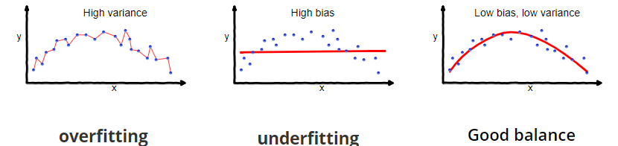
What is the TRADE-OFF?
If our model is too simple and has very few parameters then it may have high bias and low variance.
On the other hand if our model has large number of parameters then it’s going to have high variance and low bias.
So we need to find the right/good balance without overfitting and underfitting the data.

Slide 4
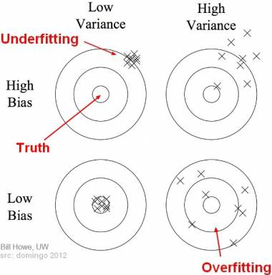
Bias and variance using bulls-eye diagram
In the diagram, center of the target is a model that perfectly predicts correct values.
As we move away from the bulls-eye our predictions become get worse and worse.
Underfitting happens when a model unable to capture the underlying pattern of the data.
Overfitting happens when our model captures the noise along with the underlying pattern in data. It happens when we train our model a lot over noisy dataset.

Slide 5
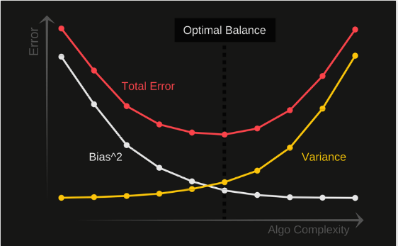
Total Error
To build a good model, we need to find a good balance between bias and variance such that it minimizes the total error.

Slide 6
If you have HIGH VARIANCE PROBLEM
You can get more training examples because a larger the dataset is more probable to get a higher predictions.
Try smaller sets of features (because you are overfitting)

Slide 7
If you have HIGH BIAS PROBLEM
Try getting additional features, you are generalizing the datasets.
Try adding polynomial features, make the model more complicated.

Slide 8
Thanks

